Slide 1
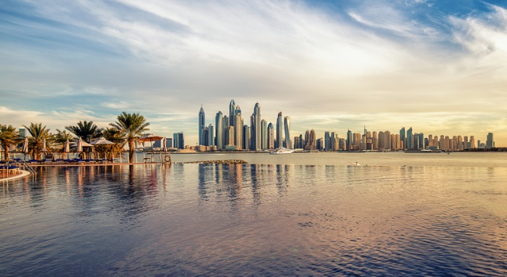
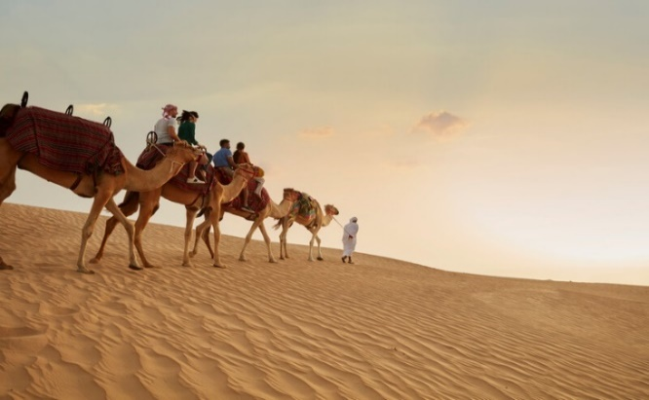
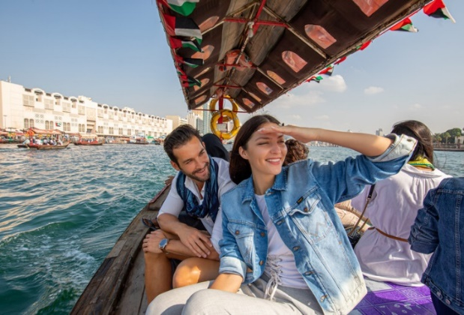
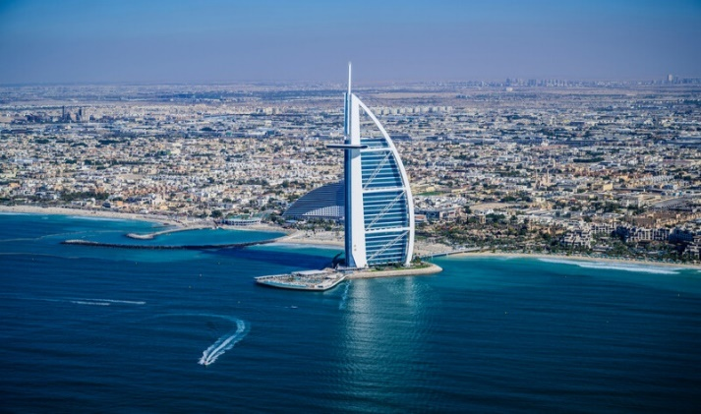
Destination Dubai
Experiences
Desert
Enjoy a tranquil dinner in the dunes
Book a thrilling dune buggy drive
Overnight safari
From up above
Private Helicopter tour
Sunrise Hot Air Balloon ride with traditional breakfast in the desert
On the water
Sunset Yacht Cruise and dinner
Self drive boat adventure
For the family
Aquaventure or Wild Wadi Water parks
Motiongate at Dubai Parks & Resorts
IMG Worlds of Adventure
Ain Dubai
Adventure lovers
Sky Dive over the Dubai Desert or Palm Jumeirah
Ski Dubai
Dubai Autodrome
General
Airport: Dubai International Airport (DXB)
Local Time: GMT +4 hours
Currency: UAE Dirham
Travel information: Dubai is approximately 7 hours flight from UK
Best time to go: October to May
Religion: Islam
Opening times: Most businesses, malls and attractions are open from 10:00 to 22:00 7 days a week
Transport: Taxis are easily available from malls and hotels. Dubai Metro has several convenient links
Dress code: Modest, loose-fitting clothing is recommended, particularly in shopping malls, souks and rural areas. Beachwear is acceptable at beach clubs, in the hotel, at the pool or on the beach
Ideal combination: Any of the Indian Ocean Islands or Egypt
Must do’s
Expo 2020 – Explore 192 Pavilions with entertainment unlike any other
Experience a whole new way to see Dubai on Ain Dubai, the world's largest and tallest observation wheel
Visit At The Top SKY, Burj Khalifa Level 148 or enjoy a Bubbly Sundowner on Level 152 of the World’s tallest tower
Take a walking tour of traditional Dubai and a food tour of the city in a group or with your own private guide
Watch the spectacular La Perle show by Franco Dragone performed in a purpose-built venue
Experience the diverse cuisines this vibrant city has to offer in this food lovers' paradise
Shop until you drop at one of the many malls or souks offering traditional, modern and unique items
Relax and unwind at the beach or indulge in one of the many spa treatments available
Hotels
Atlantis The Palm - There is an unforgettable experience for everyone, whether you are a thrill-seeker, a foodie, a sun worshipper, or an explorer
Burj Al Arab – a global icon of Arabian luxury famous for its outstanding hospitality
Bulgari Resort Dubai – stunning sea views and a fusion of Mediterranean charm with Middle Eastern embellishment
Jumeirah Al Naseem - A chic and contemporary beachside retreat
Jumeirah Al Qasr - Palatial splendour inspired by 1,001 Arabian Nights
Jumeirah Mina A’Salam - A boutique retreat steps from the beach
One&Only Royal Mirage – peaceful and serene, you will feel instantly at home
One&Only The Palm - breathtaking views of the Arabian Gulf and Dubai's soaring skyline from your private beach

Slide 2
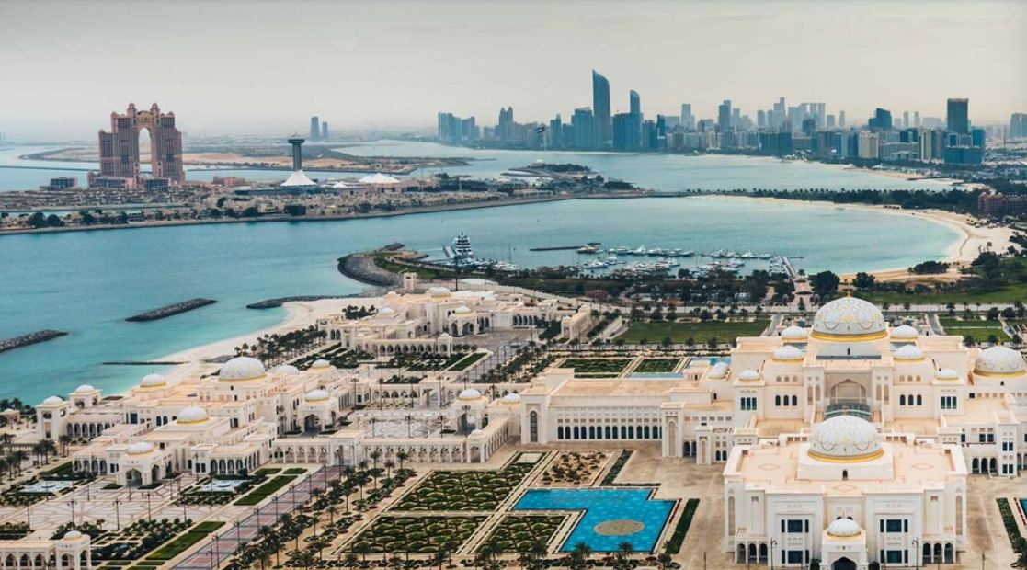
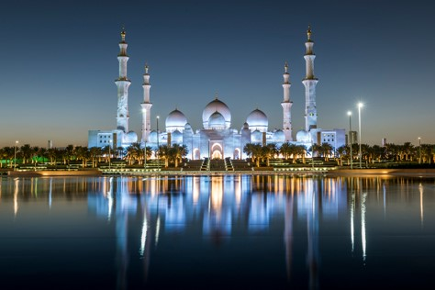
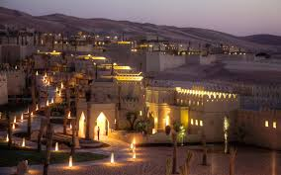
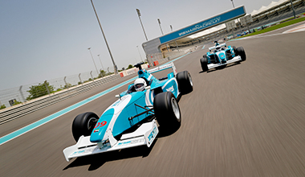
Destination Abu Dhabi
General
Airport: Abu Dhabi International Airport (DXB)
Local Time: GMT +4 hours
Currency: UAE Dirham
Travel information: Approximately 7 hours flight from UK
Best time to go: October to May
Religion: Islam
Opening times: Like in Dubai, most businesses, malls and attractions are open from 10:00 hrs to 22:00 hrs 7 days a week
Transport: Taxis are easily available from malls/hotels
Dress code: Same as in Dubai. Modest, loose-fitting clothing is recommended, particularly in shopping malls, souks and rural areas. Beachwear is acceptable at beach clubs, in the hotel, at the pool or on the beach
When visiting Sheikh Zayed Grand Mosque it is imperative to be appropriately attired
Experiences
Desert
Off road driving
Desert safari
From up above
Private Helicopter tours
On the water
Abu Dhabi Pearl journey
Kayaking, paddle boating and diving
For the family
Ferrari World Abu Dhabi
Yas Waterworld
Warner Bros World
Visit Louvre Abu Dhabi
Adventure lovers
Yas Marina Circuit driving experiences
Formula Rossa, the world’s fastest rollercoaster
Must do’s
A private guided tour of Louvre Abu Dhabi. Walk through galleries that tell the story of humanity in twelve inspiring chapters, enriched by loans from various French museums including The Louvre and Musée d’Orsay
Visit the Arabian Wildlife Park at Sir Bani Yas Island, one of the region’s largest wildlife reserves, home to more than 17,000 free-roaming animals, including Arabian oryx, gazelles, giraffes, hyenas and cheetahs
If you have a need for speed, let a professional racing driver take you for an unforgettable ride around the Yas Marina Circuit Formula 1 track in a Radical SST Supersport. You can book this as a drivir or a passenger experience
Kayaking through the Eastern Mangroves National Park. You don’t have to be an eco-tourist to appreciate one of the natural blessings of the UAE when you venture into the mangrove forest
Hotels
Emirates Palace Abu Dhabi - Located in a dazzling natural bay, this hotel offers the perfect destination with a pristine private beach and marina
Jumeirah @ Saadiyat Island Abu Dhabi - A truly idyllic seafront setting, that is perfect for a family holiday
Qasr Al Sarab Desert Resort & Spa – Set amidst the sands of Rub Al Khali, the Empty Quarter, Serenely set within the Liwa Desert, this resort is a secluded retreat with breathtaking panoramic views
W Hotel Yas Island – The hotel features a unique design, set half on land and half on water and directly overlooks the Formula 1 circuit
Zaya Nurai Island - A short 15 minute boat ride from the mainland, this boutique private island resort is surrounded by grass canopies, private beaches and unparalleled ocean views

Slide 3
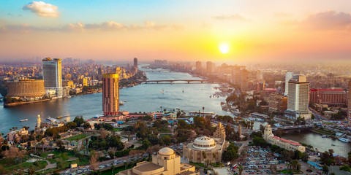
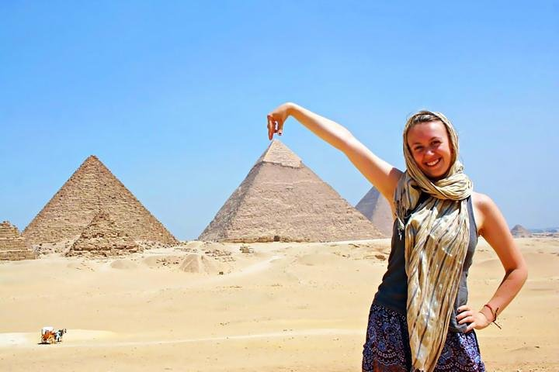
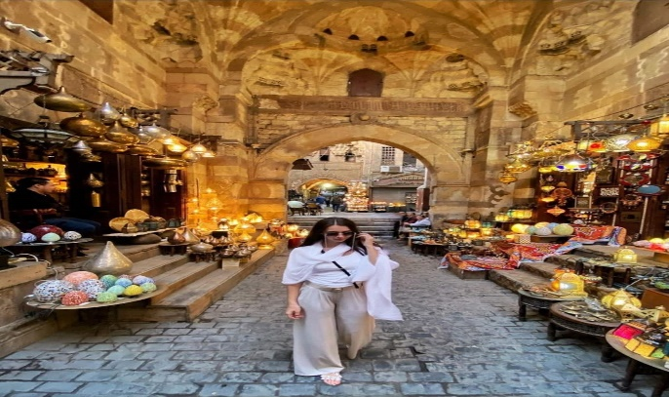
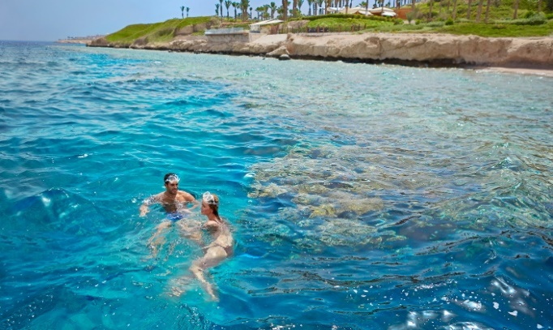
Destination Cairo & Sharm El Sheikh
General
Airports:
Cairo International Airport (CAI)
Sharm Sheikh International Airport (SSH)
Local Time: GMT +2 hours
Currency: Egyptian Pound ( EGP )
Travel information: Approximately 5 hours flight from UK
Best time to go: November to May
Religion: Islam
Opening times: Most businesses, malls and attractions are open 10:00 to 22:00 weekdays and 10:00 to 23:00 Thu-Sat
Transport: Taxis are easily accessible from malls and hotels. Limousine services available from Hotels & Airports. Cairo Metro has several convenient links. Uber service is available in all Egyptian cities.
Dress code: Modest, loose-fitting clothing, particularly in shopping malls, souks, archeological areas and rural areas. Beachwear is acceptable at hotel resorts and clubs
Ideal combination: North Africa and Levant
Experiences
Desert
Enjoy the experience of visiting Giza pyramids, sphinx & Sakkara area
Enjoy your meals overlooking Giza pyramids
Sharm Sheikh Overnight safari
Sharm Sheikh beach buggy driving
On the water
Enjoy sailing on the river Nile & dinner overlooking the Nile
Enjoy all water activities in Sharm Sheikh such as diving , snorkeling and sea cruises
For the family
The Egyptian museum in Tahrir sq. Cairo
Salah El Din citadel overlooking the city of Cairo
The Islamic antiquities such as the old gates of Cairo
Enjoy shopping in Khan El Khalili Bazar located in old Islamic part of Cairo
Adventure lovers
Sharm Sheikh night life
Ski Egypt located in Cairo Mall of Egypt
Must do’s
Test the traditional Egyptian food such as Foul , Falafel and grilled Kabab marinated with Egyptian herbs
Visit Cairo Tower one of the tallest buildings in Egypt and enjoy the magnificent view of the city during sunset
Take a walk to the old Islamic part of Cairo and observe the architecture and design in the historical buildings and markets
Visit the Hanging Church, one of the oldest churches in the world, in a group or with a private guide
Enjoy a night sailing on the Nile and or a wide variety of other Cairo night life options ranging from coffee houses, traditional bars and western clubs and bars
Enjoy relaxing on the sunny beaches of Sharm El Sheikh with a variety of water sports or discover the vibrant and varied nightlife scene
Hotels
Four Seasons Sharm - Cascading down the hillside from the desert to the Red Sea, the luxury Four Seasons Resort Sharm El Sheikh welcomes you to an Arabian fairytale
Royal Savoy Sharm – Escape to the world of luxurious facilities and impeccable service in a distinctive atmosphere by the marvelous Red Sea
Four Seasons First Residence Cairo – Catch a glimpse of the river or the Great Pyramids from your room and the newly opened First Nile Boat with access to a luxury mall
Fairmont Nile Cairo - An experience of ultimate luxury and exclusive sensation with the grandest of hospitality in the heart of Cairo
Nile Ritz Carlton Cairo - Carries a rich legacy of tradition and luxury. Overlooking the Nile lies the iconic luxury hotel, offering leisure and business travelers an opulent retreat in the heart of Cairo
Dusit Lake View Cairo - An oasis of greenery in the heart of New Cairo, it brings a taste of gracious Thai hospitality to the center of Egypt
Sofitel Cairo El Gezirah – Discover true French luxury in the heart of Cairo with magnificent views over the Nile river

Slide 4
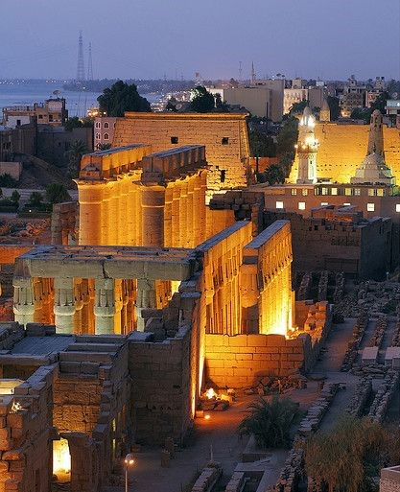
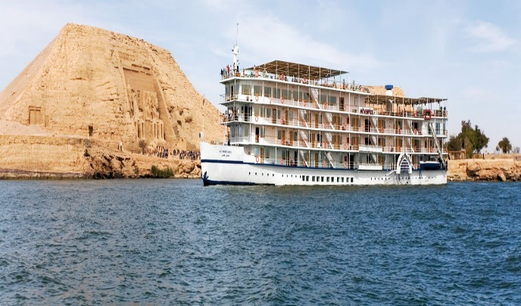
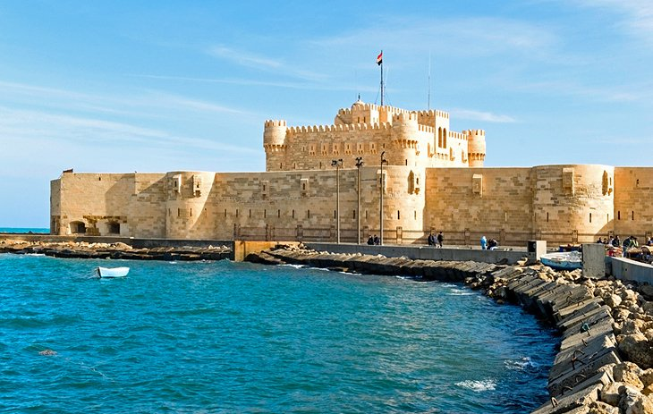
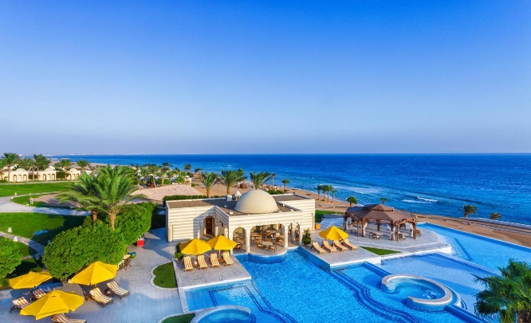
Destination Luxor - Aswan Cruise, Alexandria & Hurghada
General
Airport:
Aswan International Airport (ASW)
Luxor International Airport (LXR)
Hurghada International Airport ( HUG)
Alexandria is only 270 KM from Cairo by car
Local Time: GMT +2 hours
Currency: Egyptian Pound ( EGP )
Travel information: Approximately 7 hours flight from UK
Best time to go: November to April
Religion: Islam
Opening times: Most businesses, malls and attractions are open 10:00 to 22:00 weekdays and 10:00 to 23:00 Thu-Sat
Transport: Taxis are easily accessible from malls and hotels. Limousine services available from Hotels & Airports. Cairo Metro has several convenient links. Uber service is available in all Egyptian cities.
Dress code: Modest, loose-fitting clothing, particularly in shopping malls, souks, archeological areas and rural areas. Beachwear is acceptable at hotel resorts and clubs
Ideal combination: North Africa and Levant
Experiences
Desert
Luxor and Aswan are two great Egyptian cities that have been in existence for a very long time. Located along the River Nile, these cities have a rich historical background and equally interesting cultural traditions. Luxor and Aswan are known to be the home of almost all the remaining intact ancient Egyptian temples that date back to around 5000 years!
Enjoy Hurghada Overnight safari and barbeque
On the water & Family
Savor the timeless experience that is a Nile cruise as you sail from Aswan to Luxor on an indulgent ship with onboard swimming pool. Feast on breakfast, lunch, dinner—and even afternoon tea—as you discover ancient Egypt’s highlights. Professional Egyptologists are on hand as you visit the temples of Philae, Kom Ombo, Edfu, Luxor and Karnak
Enjoy all water activities in Hurghada such as diving, snorkeling and sea cruises
Enjoy the Mediterranean sea in the modern city of Alexandria, was built in 331 Bc by Alexander The Great and ruled by Cleopatra
Must do’s
Explore the Museums of the Bibliotheca Alexandrina, Catacombs of Kom el-Shuqqafa and Fort Qaitbey who stand by the Alexandria famous Corniche
Take a deep walk into history and enjoy visiting the great temples in Luxor and Aswan such as Karnak, Abu Simble and Philae. Enjoy your visit with a private tour leader or within a group
Visit the colorful souk in Aswan along with the Nubian Village and enjoy all kinds of handmade traditional clothes and Antiques
Enjoy relaxing on the sunny beaches of Hurghada with different water sports activities or enjoy group diving with trainer
Nile cruise trips offers a great chance to enjoy the beautiful scenery of the river Nile. Discover magnificent temples and tombs of the ancient world on your cruise soaked in ancient Egyptian history
Enjoy night life in Alexandria, clubbing by the sea and sea food with different recipes, as well as nightlife by the sea
Hotels
Movenpick Nile Cruise Luxor & Aswan - Movenpick Nile cruise ships send you on a luxury and fascinating journey on one of the world’s most famous and beautiful rivers
Oberoi Nile Cruise Luxor & Aswan – Experience the best River Nile cruise on board this five star cruise
Historia Nile Cruise Luxor & Aswan - Evoking the spirits of time long past with the relevance of today, Historia exposes the scenery of fluttering and cream linen curtains on an aged old deck; One with stories to tell and things that have been seen
Oberoi Sahl Hasheesh Hurghada - 5-star luxury hotel in Sahl Hasheesh has been carefully designed to allow you space. It features high domed ceilings, is bathed in natural light and dotted with traditional design elements
Hilton Hurghada Plaza - Adjacent to Hurghada City Center Shopping Mall and facing the Red Sea
Four Seasons St Stefano Alexandria – With Egyptian underpinnings and a sleek waterfront setting, this resort-style Hotel embodies modern Alexandria and its unique cosmopolitan flare.
Movenpick Aswan Hotel - Pleasing its guests with a spectacular view over the river Nile Movenpick Resort Aswan offers a unique location on Elephantine Island.

Slide 5
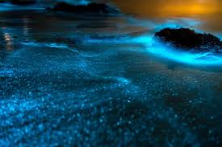
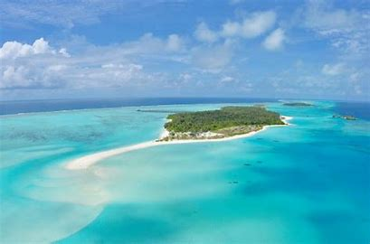
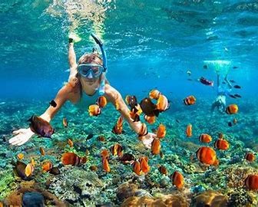
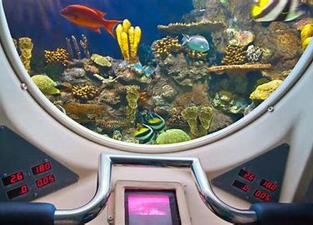
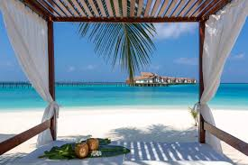
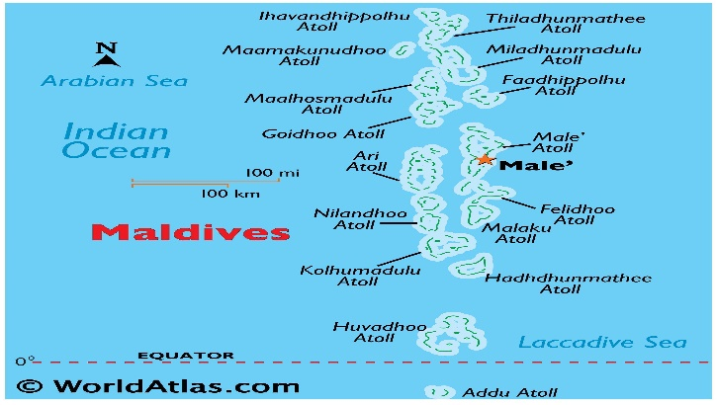
Destination Maldives
General
Airport: Velena International Airport (MLE)
Local Time: GMT +5 hours
Currency: Maldivian Ru­fiyaa
Travel Information: Approximately 12 hours from UK
Best time to go: November to April
warm and sunny all year round average 23-31 degrees
Religion: Islam
Transport: The two principal ways of travelling around are by boat or seaplane. There are private charters available or you can take an excursion or 'photo flight' from your resort. Public ferry services are also available between the atolls.
Dress Code: resort casual. Some tourists choose to dress up, but the dress code on most islands is relaxed. Outside of resort areas, dress modestly.
Ideal Combination: Maldives is a perfect destination to add to a Dubai or Abu Dhabi city break
Experiences
From up above:
• Seaplane and helicopter tours
On the water:
• Surfi­ng, diving, fi­shing and snorkeling
• Submarine tours
For the family:
• Cooking classes
• Non-motorized watersports
• Private boat cruise
Adventure lovers:
• Skydiving
• Parasailing
• Surfi­ng
• Water skiing and flyboarding
Nature enthusiasts:
• Dolphin spotting
• Eco tour to Vilimale Island
Must do’s
• Save a day for a tour of Male City by car or on foot
• Take a submarine tour of the underwater world
• China Maldives Friendship Bridge is a major attraction, 2.1 km long with separate lanes for pedestrians, cars and bikes, it connects Male to the airport Hulhule
• Enjoy a day exploring a small part of the Maldives archipelago. Combine snorkel points with a local island tour, lunch and complete the day with a sunset cruise in search of dolphins
• Don’t miss your chance to snorkel with nurse sharks
and other marine wildlife. Dolphin watching can also be arranged
• Island hopping by boat. Learn the culture and
traditions of the islands by visiting a boat building yard. Between islands, make some stops for snorkeling and swimming to explore underwater
• Visit Glowing Beach on Vaadhoo Island in Raa Atoll
Hotels
Ozen Reserve Bolifushi - surrounded by a natural reef
and turquoise waters, the private island resort exudes elegance and style. Offering overwater villas with slides, fine dining and ice skating by the beach
• JOALI Maldives - Hidden away in the northern reaches of the Maldives, JOALI is situated on Muravandhoo Island in the Raa Atoll, one of the largest and deepest in the world
• One&Only Reethi Rah - Surrounded by the wonders of the Indian Ocean, this all villa resort makes its home on one of the largest islands in North Male Atoll. A jewel among a string of coral atolls, lagoons and white sands
• Jumeirah Maldives - An island villa retreat set on the white sands of Olhahali Island. The epitome of beachfront and overwater living
• Soneva Fushi - The original luxury desert island hideaway in the Maldives, boasting beachfront villas and eight water retreats ranging in size from one to nine bedrooms

Slide 6
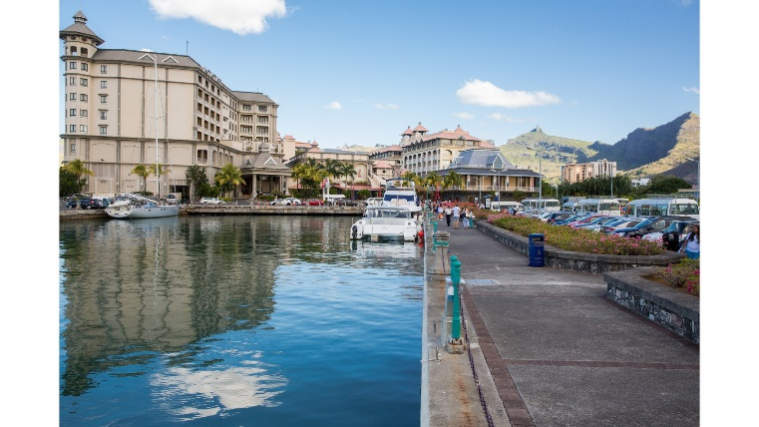
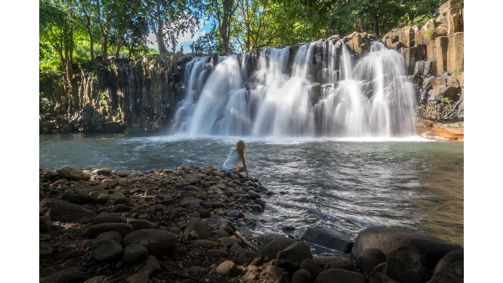
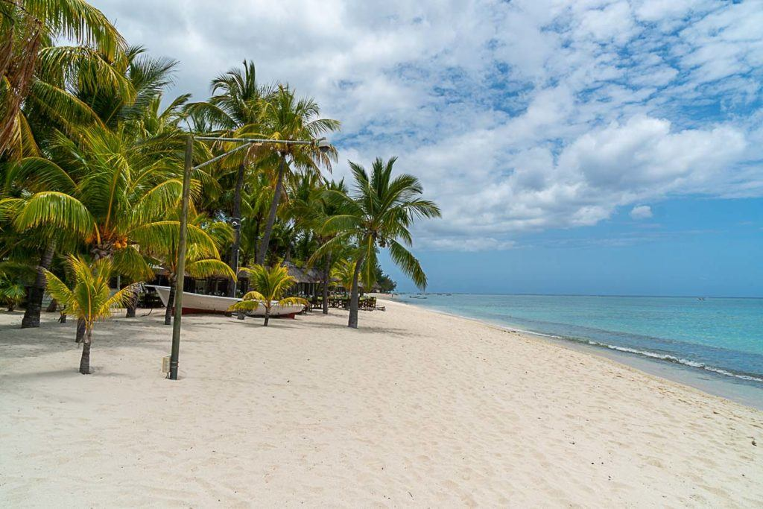
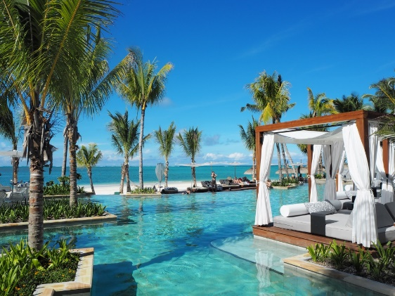
Destination Mauritius
Experiences
For land-lovers and nature enthusiasts
Golfing
Green and Eco Tours
From up above
Helicopter tours
On the water
Sailing, catamaran or yacht cruising
Diving, fishing and snorkeling
Whale and dolphin spotting
For the family
Nature walks at River Gorges National Park, Ebony Forest in Chamarel or the Bras d'Eau National Park in the East
Pamplemousses Botanical Garden
Mauritius Aquarium
Adventure lovers
Several watersports including kite surfing, parasailing and kayaking
Skydiving
Hiking
General
Airport: Sir Seewoosagur Ramgoolam International Airport (MRU)
Local Time: GMT +4 hours
Currency: Mauritian Rupee
Travel information: Mauritius is approximately 12 hours flight from UK
Best time to go: April-June September-December
Religion: Hinduism
Transport: Taxi services are available at hotels and throughout the island
Dress code: Casual. Mostly beach and pool wear
Must do’s
Visit Port Louis, the capital city. Start at the Caudan Waterfront and walk to the bustling and colourful Central Market in Port Louis. Stroll the streets towards Royal Road, and you will reach Chinatown
Private catamaran or yacht cruise
Nature walks at River Gorges National Park, Ebony Forest in Chamarel, the Bras d'Eau National Park in the East or Pamplemousses Botanical Garden
Le Morne Brabant is a UNESCO World Heritage Site due to its poignant history. The mountain provided shelter for escaped slaves during the 18th and early 19th Century
Visit Chamarel Waterfalls, twin waterfalls tumble around 100 metres into the pool below. Take in also the Seven-coloured Earth located in the heights of Chamarel
Cook traditional Mauritian food with a local
Hotels
LUX Belle Mare Resort & Villas - Beautiful property on the wild east coast of Mauritius featuring island living at its best
LUX Grand Baie Resort & Residences – Brand new, modern, boutique style resort on the northern shores of Mauritius
Lux Le Morne Resort – A chic and serene resort at the foot of Le Morne mountain. A haven for lovers of barefoot luxury, with a postcard beach
One&Only Saint Géran - nestled on a pristine private peninsula with almost 2 km of sandy beach
Tamassa – Vibrant resort on the Southwest Coast of Mauritius surrounded by dramatic mountains and dense sugarcane fields

Slide 7
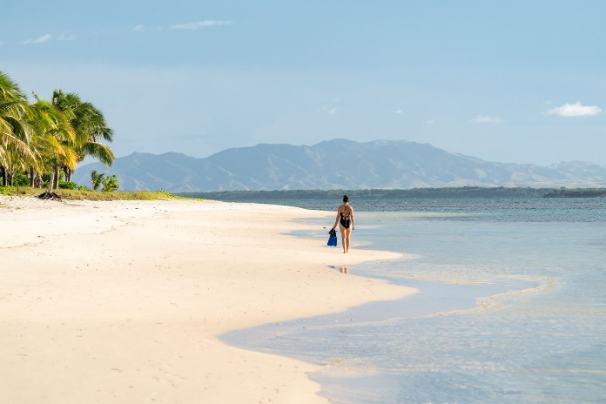
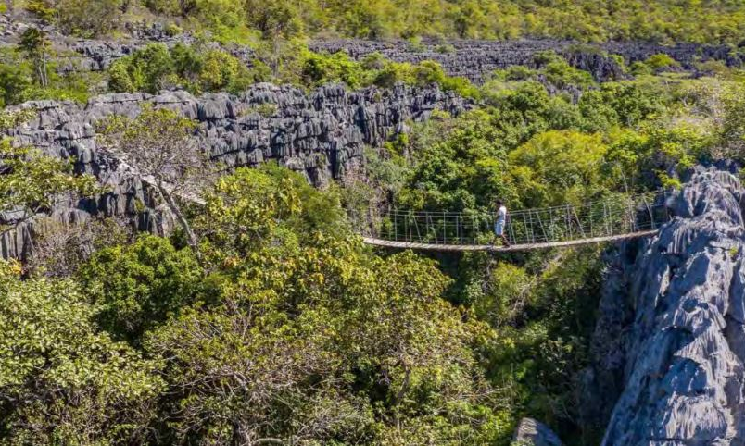
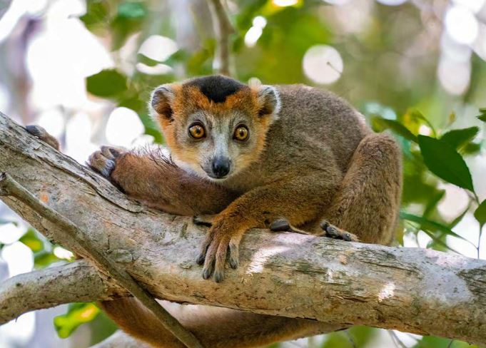
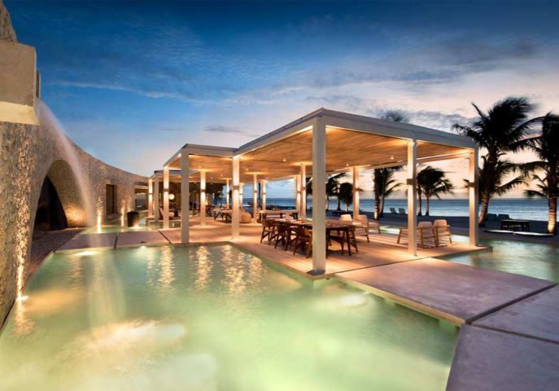
Destination Madagascar Miavana Private Island Sanctuary by Time + Tide
Experiences
For land-lovers and nature enthusiasts
Guided treks
Wildlife experiences
From up above
Helicopter tours
On the water
Snorkeling, scuba diving, fishing, boating
Stand-up paddle boarding, kayaking, kite boarding, wake boarding and water skiing
For the family
Activities available for kids include treasure hunts, scavenger hunt, local games of petanque, PADI Bubblemaker, kids fishing
Adventure lovers
Quad biking
Bicycling
Trekking
General
Airport: This luxury private island retreat is only accessible by a 30 minute helicopter flight from Arrachart Airport (formerly Diego Suarez Airport) or 60 minutes from Nosy Be Airport in Madagascar
Local Time: GMT +3 hours
Currency: Malagasy Ariary
Travel information: Mauritius is approximately 14 hours flight from UK
Best time to go: April-December
Religion: Christianity
Transport: The island is a sanctuary accessible only by helicopter
Dress code: Casual. Mostly beach and pool wear
Must do’s
Hop on a quad bike (ATV) to explore the island from top to toe. Miavana is 5km long by 2km wide, with 10 square kilometres of land to explore. Pass through a local village and stop off at the Lighthouse, which offers spectacular 360-degree views across the archipelago to the mountains on Madagascar’s mainland
Understand the complexities of vanilla production at one of the world’s premier plantations. Vanilla is a fascinating product and Madagascar is the world’s largest producer of this valuable crop
Meet Miavana’s resident population of Crowned Lemurs while trekking through pristine forests
December to April is sea turtle nesting and hatching season
From June to September spot dolphins and migrating humpback whales as you gaze out over the Indian Ocean
Miavana by Time & Tide
Miavana is a haven of luxury located on the largest island in a secluded archipelago off the northeastern coast of Madagascar. The resort brings together world class luxury in a world of rare wildlife and extraordinary landscapes
The intimate resort offers 8 one-bedroom villas, 4 two-bedroom villas and 2 three-bedroom villas. Each with an oceanfront verandah, floor-to-ceiling retractable glass windows, spacious lounge, dining area, a kitchenette and personal bar
Each villa also offers 24 x 7 butler service, eco-cooled sleeping spaces, indoor and outdoor showers and soaking tubs overlooking the ocean
At The Piazza, with views overlooking the beach, the mountains and beyond, dine, sip a cocktail at sunset and relax in an array of spaces to suit your every need

Slide 8
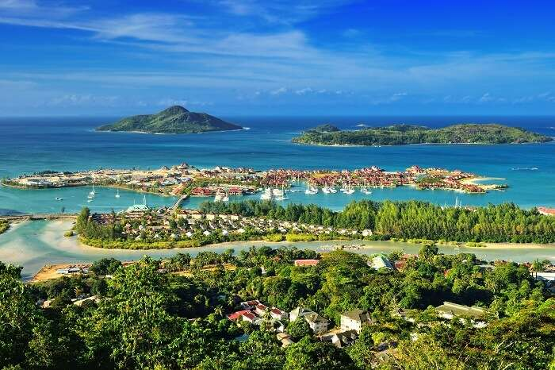
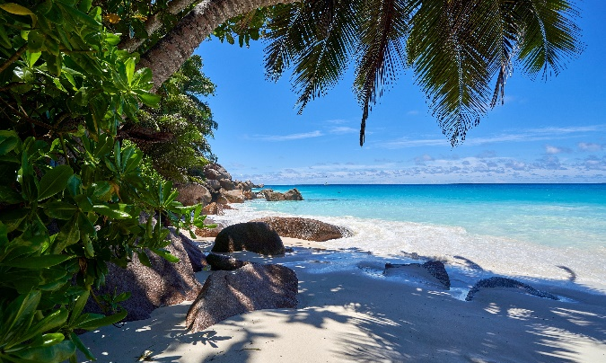
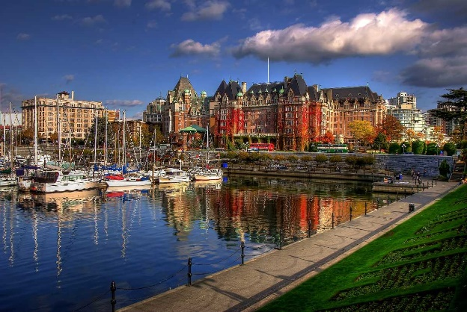
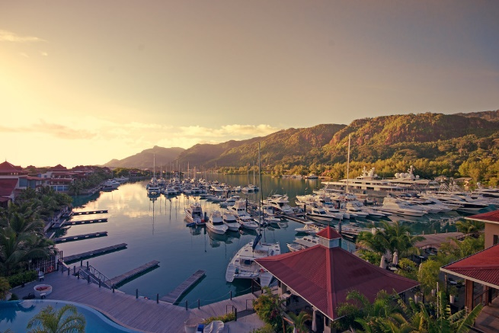
Destination Seychelles
Experiences
For land-lovers and nature enthusiasts
Morne National Park
Coconut Plantation House
Vallee De Mai, a UNESCO World Heritage Site
Sainte Anne Marine Park, Cerf Island
From up above
Helicopter tours
On the water
Snorkeling, scuba diving, fishing, cruising
For the family
Relax on some of the world’s best beaches
Island hopping – Mahe, Praslin, Silhouette Island, Eden Island, La Digue
Adventure lovers
Trekking The Copolia Trail
Hiking
Rock climbing
Ziplining
General
Airport: Seychelles International Airport Aéroport de la Pointe Larue
Local Time: GMT +4 hours
Currency: Seychellois Rupee
Travel information: Seychelles is approximately 10 hours flight from UK
Best time to go: April-May October-November
Religion: Christianity
Transport: Car rental services are available in Mahe and Praslin. From island to island it is necessary to organize transfers by boat or seaplane
Dress code: Casual. Mostly beach and pool wear
Must do’s
Visit the tiny town of Victoria on Mahe Island, one of the world’s smallest capitals
Go to La Digue’s coconut plantation, home to the stunning Anse Source d’Argent beach
Meet giant tortoises on Curieuse Island or Cousin Island
From September to December, watch baby Hawksbill sea turtles venture into the sea where they lay eggs in broad daylight!
Take a boat trip around the islands the more popular ones being Cousin Island for its diverse wildlife, Curieuse Island with magnificent mango forests and St. Pierre is popular for its snorkeling spots
Explore the Vallée de Mai on Praslin, an ancient forest filled with Coco de Mer palms
A UNESCO World Heritage Site, Aldabra is the world's largest raised coral atoll
Hotels
Constance Ephelia Mahe Island is situated on two of the most beautiful beaches on the island of Mahé, overlooking the marine national park of Port Launay
Four Seasons Resort Seychelles overlooks one of the best-secluded beaches in Mahé. Hillside villas perched on stilts, each with private pool, provide a private sanctuary with an idyllic view
Banyan Tree Seychelles, a colonial-style hotel is surrounded by tropical rainforest and overlooks Intendance Bay
Six Senses Zil Pasyon offers indulgent villas and facilities nestled in and around lush vegetation, rocky coastline and three white-sand beaches
Kempinski Resort Seychelles, at the south end of Mahé in Baie Lazare, is an ideal retreat offering a huge variety of facilities and activities

